Slide 1
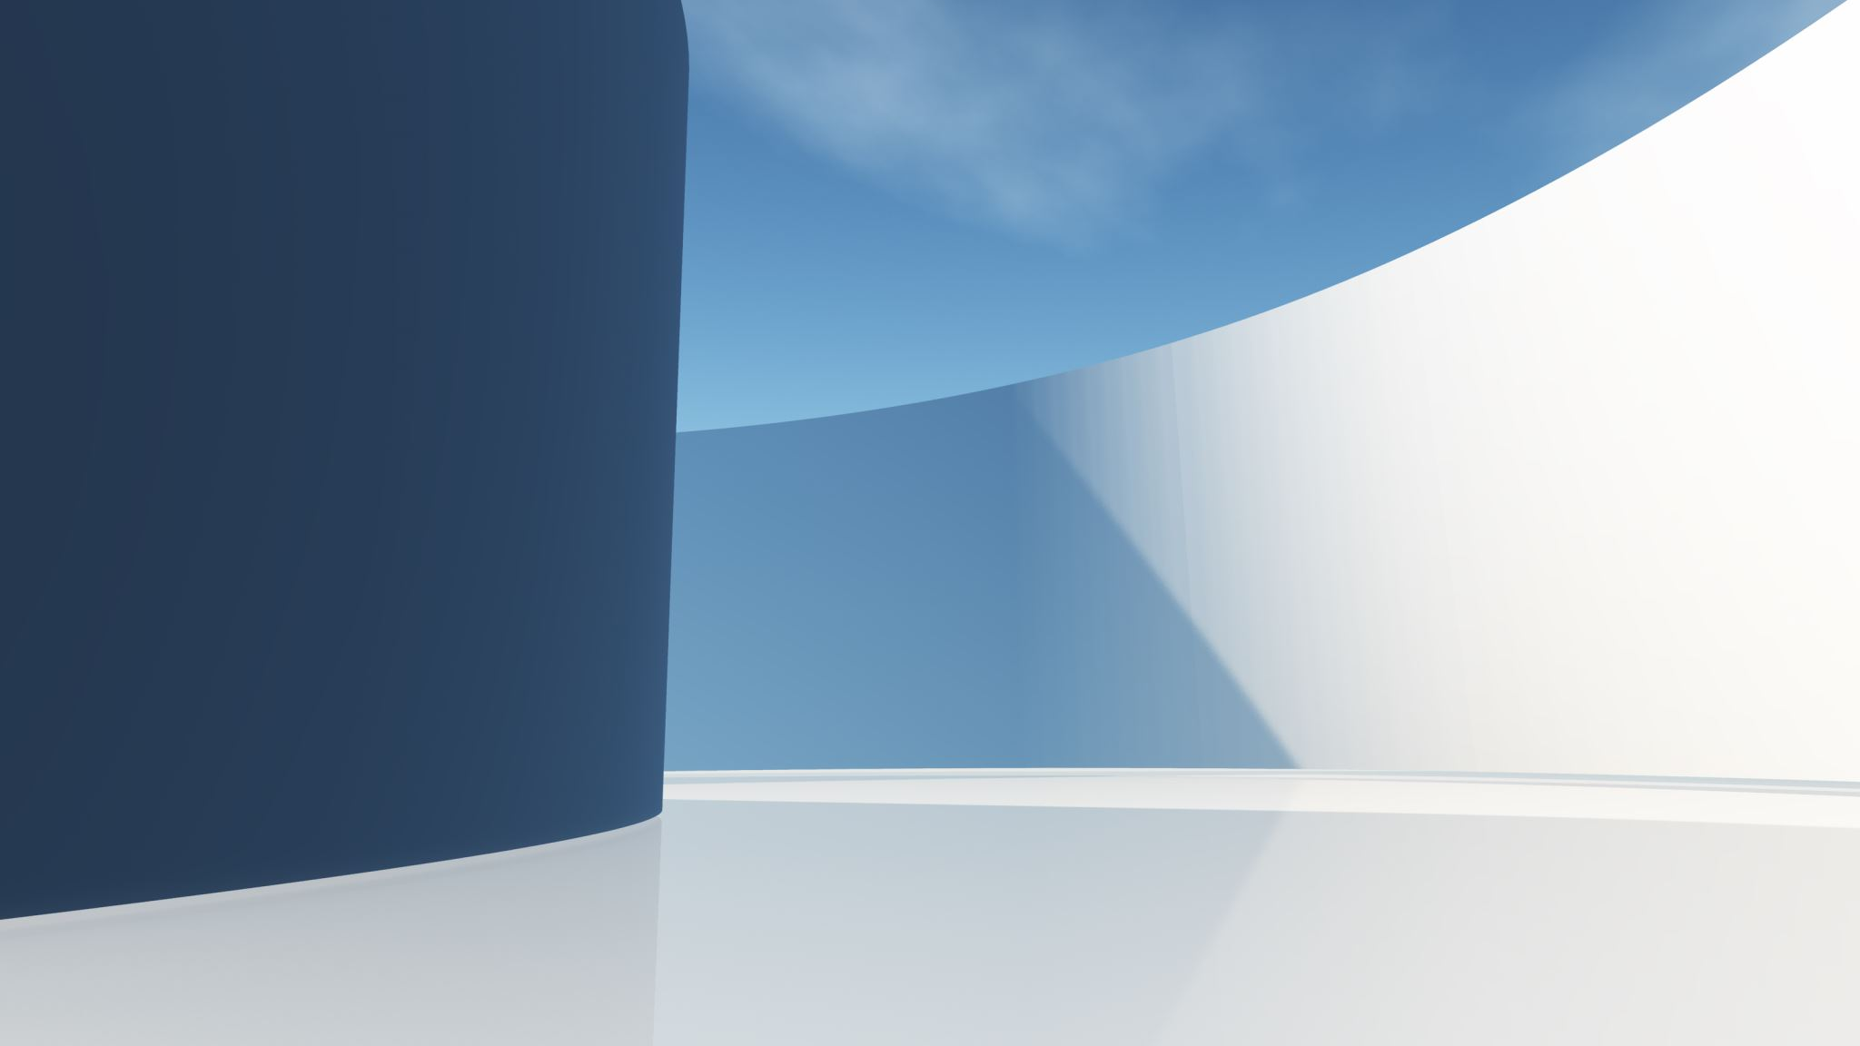
CUSTOMER SERVICE
SUBMITTED BY: ARSHDEEP SINGH

Slide 2
FILES INCLUDED
RestAPI folder which has the Spring Boot application and the Docker file.
It also consists of HTML file (UI)

Slide 3

About the application
This is a Spring Boot application with a hardcode Json data (Customer.json) and it consists of 4 GET API menthods.
The application end points used are
/customers : Gets us list of customers
/customers/{id} : Gets a particular user details
/customers/{id}/orders : Get orders for particular user.
/customers/{id}/orders/{id} : Here we fetch one particular order of a particular user.
We then create a Docker file and build and run it to create a Docker Container which will fetch us the above data.
Then we use a webpage (simple frontend UI) to show the endpoints in action.

Slide 4
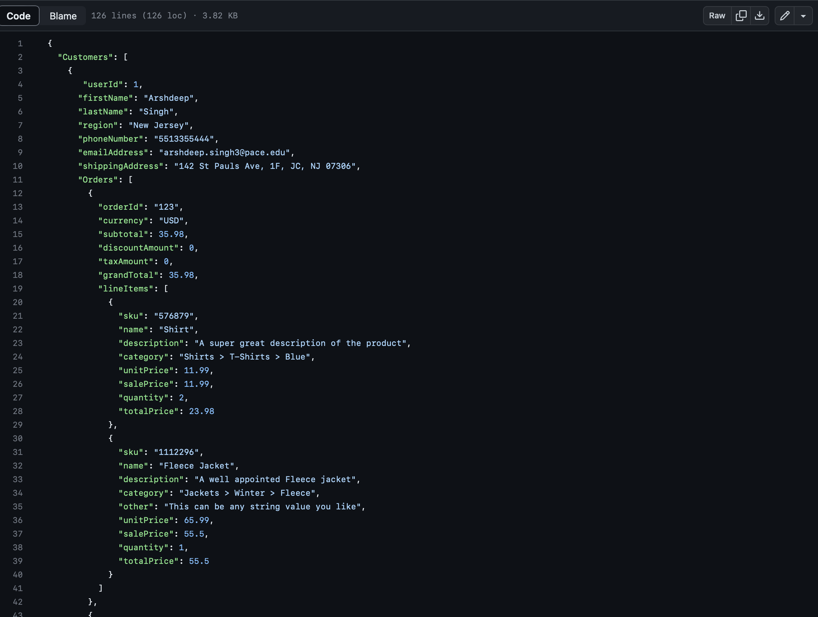
SCREENSHOT
It basically gathers the name of customers with all details including address, phone number and email address.
According to the customer's purchase it makes the bill according to the purchase and quantity of each item.

Slide 5
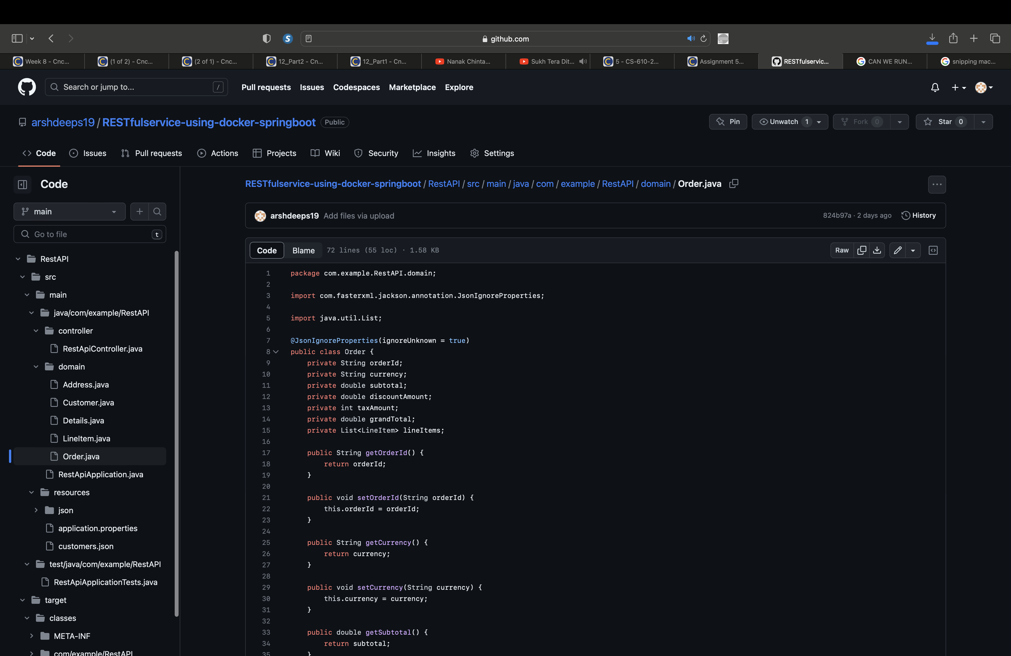
SCREENSHOT
It has various components which accounts for
order id
currency in which the payment has to be made
discount amount if it applies on that product
tax which will be charged on the particular item
grand total which the customer has to pay

Slide 6

THANKYOU
MADE BY: ARSHDEEP SINGH
CS-612
Cncpts & Strctrs:Intrnt Cmptng SPRING 2023 21133

